Slide 1

THE NATIONAL INSTITUTE OF ENGINEERING
DEPARTMENT OF MASTER OF COMPUTER APPLICATIONS
MAJOR PROJECT
(2MCA4C03)
PROJECT TITLE
LIVER CANCER SEGMENTATION AND CLASSIFICATION
UNDER THE GUIDANCE OF
Dr. SANJAY KUMAR C K
Assistant Professor & HoD, Dept. of MCA
NIE, Mysuru
Presented By:
DHRUVA KUMAR K M
4NI21MC013

Slide 2
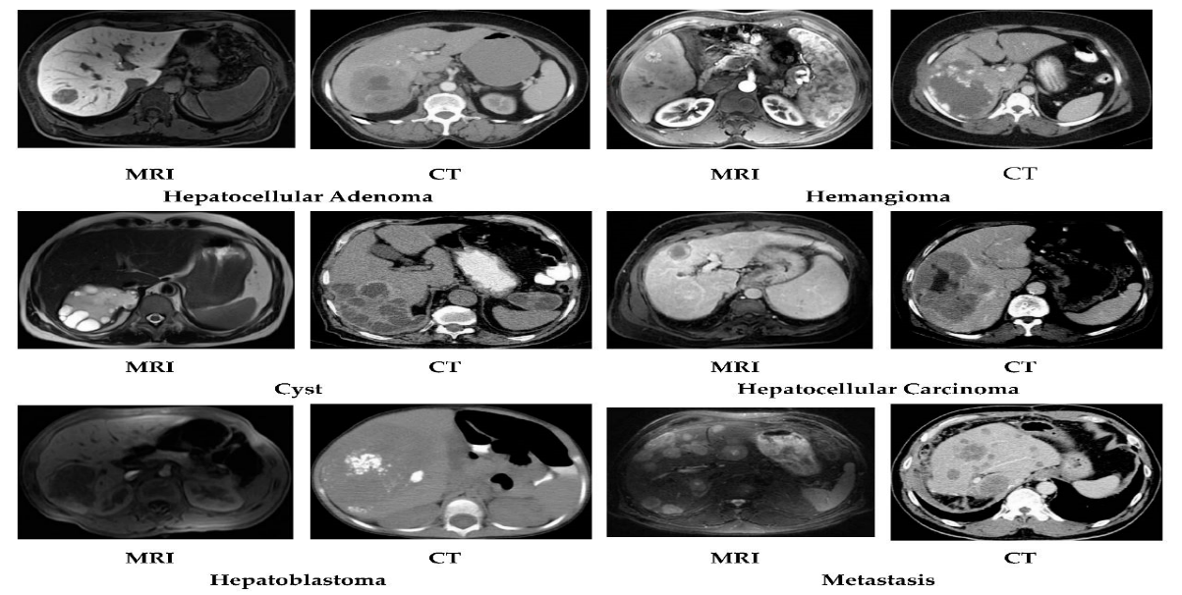
Abstract
Liver cancer is an illness that could be fatal and also one of the world's fastest-growing cancers types. Lower death rates result through the early identification of tumors in the liver. By examining photos of tissue obtained from a biopsy of this tumor, the goal of this research is to build a model that can assist clinicians in identifying the tumors when it develops in the liver's area.
To evaluate whether the tumor is malignant and requires therapy, a tissue expert must put up the effort, take the necessary time, and gather the necessary experience. Therefore, a specialist can utilise this model to establish a preliminary diagnosis. Convolutional Neural Networks (CNNs), which can transmit knowledge, will be used in this study to suggest a deep learning model.

Slide 3
Introduction
The need of an immediate and precise diagnosis can't be emphasised in the healthcare field where liver cancer cases are rising. Identification of liver abnormalities has benefited by the utilisation of diagnostic imaging procedures like computed tomography (CT) scans. However, this process often demands substantial human effort and expertise. Our project's goal is to utilise the potential of deep learning, more especially CNN, to handle this difficulty, in automating the intricate tasks of segmenting and classifying liver tumors within CT scan images. The primary objective of this effort is to create a sophisticated deep learning system leveraging on CNN that will automate the difficult process of segmenting and categorising liver cancer utilising computed tomography (CT) pictures. Our aim is to enhance the accuracy and efficiency of diagnosing liver tumors, thereby contributing to timely and precise medical interventions. Through the development of this automated solution, we seek to alleviate the burden on healthcare professionals, enabling them to focus on critical decision-making while improving patient outcomes and streamlining healthcare workflows in the context of liver cancer diagnosis.

Slide 4
PROBLEM STATEMENT
The core challenge at hand revolves around the laborious and time-intensive process of manually segmenting and classifying liver tumors within CT scans. Healthcare professionals face significant difficulties in meticulously identifying tumor regions and categorizing them based on them. Our project seeks to tackle this challenge by developing an automated solution that possesses the capability to precisely delineate liver tumors from CT scan images and subsequently categorize them into distinct types.

Slide 5
Existing system
Today's healthcare industry offers numerous benefits, including fraud detection and cost-effective medical facilities. However, automating liver cancer diagnosis is an unaddressed need.
The existing system employed ML techniques like Decision Tree, K-Nearest Neighbour, and Naive Bayes Classifier, but faced accuracy issues, highlighting the demand for improved diagnostic methods.
LIMITATIONS OF EXISTING SYSTEM :
Manual Segmentation: Current methods rely on manual segmentation, which is slow, prone to variability among observers, and unsuitable for extensive datasets.
Limited Diagnostic Accuracy: Existing automated approaches may lack the precision required for trustworthy diagnoses, leading to potential misinterpretations.
Complex Pattern Recognition: Traditional feature engineering struggles to capture intricate patterns and variations in liver tumors.
Scalability Challenges: Scaling existing methods for large datasets could hinder their adoption in clinical practice due to potential scalability issues.

Slide 6
Proposed system
Advanced Deep Learning for Liver Cancer Prediction: The proposed system leverages advanced deep learning techniques, particularly Convolutional Neural Networks (CNNs), to automate liver cancer prediction and classification. This approach offers a comprehensive framework for image analysis related to liver cancer.
Timely Detection of Early-Stage Liver Cancer: The system aims to facilitate the timely detection of early-stage liver cancer, especially in pediatric patients, by applying deep learning methodologies. Initial results demonstrate promising improvements over existing tools, warranting further validation with larger datasets and clinical trials.
Potential for Neurological Insights: Additionally, this deep learning framework may offer valuable insights into neural intricacies, potentially contributing to research in other domains such as autism, highlighting its multifaceted applications.

Slide 7
CONT…
Advantages of proposed system:
Automation for Efficiency: The proposed system automates the diagnosis process, eliminating the need for manual segmentation and significantly reducing the time and effort required for liver cancer diagnosis.
Enhanced Accuracy: Leveraging deep learning techniques enhances the accuracy and consistency of tumor segmentation and classification, leading to more reliable results.
Real-time Diagnosis: Automated segmentation and classification enable real-time diagnosis, facilitating prompt medical decision-making and potentially expediting patient treatment.
Scalability: The model is designed to efficiently handle large volumes of data, making it suitable for clinical settings where extensive data processing is required.
Objective and Reproducible Results: The system's automated approach reduces inter-observer variability, providing objective and reproducible diagnostic outcomes.
Early Detection Potential: The system's accuracy and efficiency in detecting liver tumors have the potential to lead to earlier interventions, ultimately improving patient outcomes.

Slide 8
LITERATURE SURVEY
[1] "Performance analysis of liver tumor classification using machine learning algorithms", Munipraveena Rela, Suryakari Nagaraja Rao and Patil Ramana Reddy
Summary: This paper evaluates machine learning techniques for liver tumor categorization, emphasizing the importance of medical imaging in tumor identification, diagnosis, and treatment planning. Challenges in liver tumor segmentation, arising from poor contrast and indistinct boundaries, are addressed using multiphase contrast-enhanced CT imaging. Various algorithms, including Support Vector Machine (SVM), K-nearest-neighbor (KNN), Decision Tree (DT), ensemble methods, and Naive Bayes (NB), are applied for classification. Using a dataset comprising 68 CT images with 86 features, the study shows that SVM outperforms other methods, achieving 85% accuracy. DT and ensemble methods exhibit lower accuracy, suggesting SVM's potential as a promising algorithm for liver tumor categorization.

Slide 9
CONT…
[2] "Support Vector Machine based Liver Cancer Early Detection using Magnetic Resonance Images", Lei Meng, Changyun Wen, and Guoqi Li
Summary: This paper employs SVM algorithm for timely liver cancer detection through MRI scans. The algorithm extract relevant data from MRIs. It is trained on a dataset of 100 confirmed liver cancer cases, achieving an impressive 86.67% accuracy in early-stage cancer categorization. The study underscores the importance of early liver cancer detection and MRI's potential as a robust diagnostic tool. The fusion of machine learning and MRI scans has proven successful in classifying various conditions. The authors plan to enhance their system by exploring advanced features from texture analysis and sophisticated classification methods, aiming to improve accuracy and effectiveness.

Slide 10
CONT…
[3] "Hepatocellular Carcinoma (HCC) Liver Cancer prediction using Machine Learning Algorithms", Sanapala Rajesh, Nurul Choudhury, and Soumen Moulik
Summary: This research article centers around the enhancement of disease prediction through the machine learning. To validate the efficacy of the proposed system, SVM, Naive Bayes, and KNN algorithms are employed for evaluation. Key to this model are the Naive Bayes and KNN algorithms, strategically chosen to heighten precision and efficacy by generating supplementary data. The study encompasses a comprehensive exploration of diverse machine learning algorithms, each applied to disease prediction. This includes the utilization of SVM, random forests, logistic regression, and decision trees. In the pursuit of optimal outcomes, the authors further investigate the strategic employment of feature extraction and dataset partitioning techniques.

Slide 11
SYSTEM REQUIREMENTS
Software Requirements
IDE : FLASK
Language : Python
Tool : Jupyter Notebook
Software : Anaconda
Front End : HTML, CSS
Libraries : Tensorflow, Keras, NumPy, Pandas
Hardware Requirements
RAM : 2 GB
Hard disk : 100 GB
Process : 32/64 Pentium

Slide 12
METHODOLOGY
Dataset Acquisition: We obtained our dataset from Kaggle, a trusted source for diverse datasets suitable for data analysis projects. Our dataset includes instances of liver disease, structured into two distinct classes.
Data Pre-Processing: We applied crucial data pre-processing techniques, including image resizing, to enhance the dataset's quality and prepare it for model training. This step ensures consistency in image size, minimizing discrepancies.
Data Modeling with CNN: Our methodology centers around Convolutional Neural Networks (CNNs), which excel in image-related tasks by recognizing spatial patterns. The CNN algorithm is trained on a dedicated subset, learning to identify features distinguishing between liver disease classes.

Slide 13
CONT…
Model Evaluation: We assessed the model's effectiveness using a testing subset, generating accuracy metrics such as precision, recall, and F1-score to gauge performance.
Model Building and Saving: Upon achieving satisfactory accuracy, we built and saved the model. This final step encapsulates the network architecture and learned parameters, providing a reliable tool for real-world liver disease identification based on medical images.

Slide 14
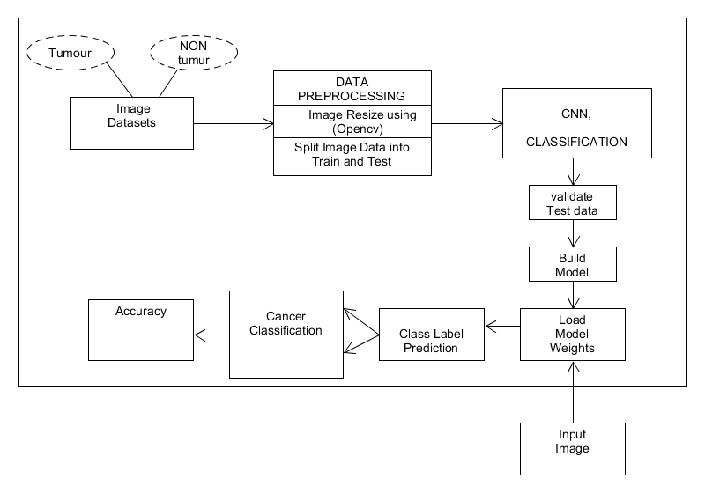
SYSTEM ARCHITECTURE
The project begins with the dataset collecting. Collected Kaggle datasets of liver tumor and non-tumor.
Pre-processing of acquired datasets chooses characteristics that aid in identifying the liver cancer.
Data preprocessing techniques are used to preprocess the dataset.
Using the OpenCV library, all of the collected images are scaled to a specific size.
Dataset is divided into two sections: one for training and the other for testing.
The CNN method is used to train the chosen datasets.
The correctness of the datasets is evaluated.

Slide 15
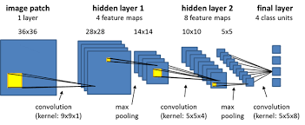
CONVOLUTIONAL NEURAL NETWORK(CNN)
A Convolutional Neural Network (CNN) is a type of deep neural network designed for processing and analyzing visual data, such as images and videos.
CNNs are particularly effective in tasks that involve understanding patterns and hierarchies of features within images.
They've revolutionized computer vision tasks by enabling computers to perform tasks like image classification, object detection, segmentation, and more.

Slide 16
CONT…
CNN have the following:
Convolutional Layer
ReLU
Pooling Layer
Fully Connected Layer
Convolution Layer
The first layer used to extract information from an input image is convolution. Convolution preserves the connection between pixels while learning visual features from small input data squares. For this mathematical process, two inputs are needed, such as an image matrix and a filter or kernel.

Slide 17
CONT…
ReLU
In this, we eliminate every negative value from the filtered photos and replaces them with zeros. To prevent the values from adding up to zero, it is happening.
Rectified Linear Unit (ReLU) transform functions only activate a node if the input value is higher than a specific threshold.
When the information rises above a threshold, the output changes from zero while the data is below zero. It and the dependent variable are related linearly.
Pooling Layer
If the images were too huge, the section on layer pooling would limit the number of parameters. It lowers the dimensionality of each map while preserving crucial information. It comes in a variety of forms, including:
Max Pooling
Average Pooling
Sum Pooling
Using max pooling, the largest element in the rectified feature map is chosen. Instead of only using the biggest element, one may use the average pooling. Summation of all feature map components is referred to as sum pooling.

Slide 18
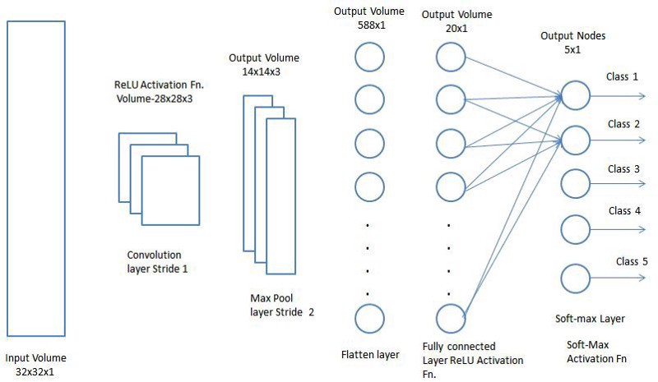
CONT…
Fully Connected Layer
A (typically) low-cost method of learning non-linear combinations of the high-level attributes represented by the output of the convolutional layer is to add a Fully-Connected layer.
In that location, the Fully-Connected layer is now learning a function that might not be linear. A CNN network picture is shown in below Figure.

Slide 19
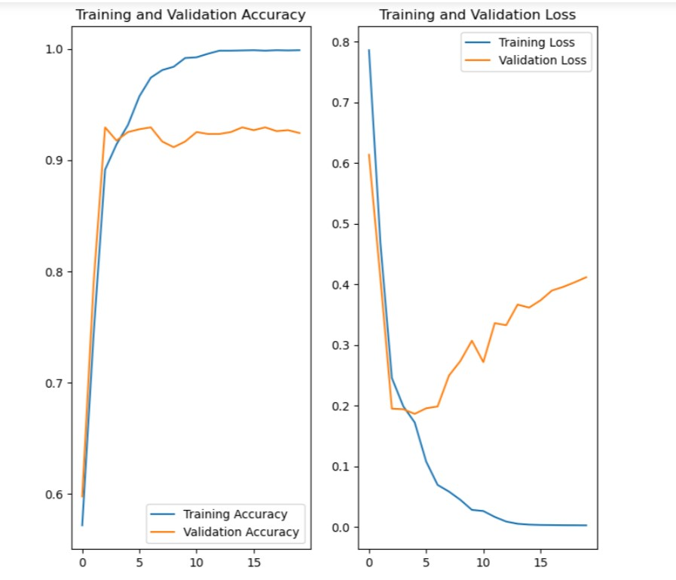
SCREENSHOTS
Progress of training the CNN model on our dataset for 20 epochs

Slide 20
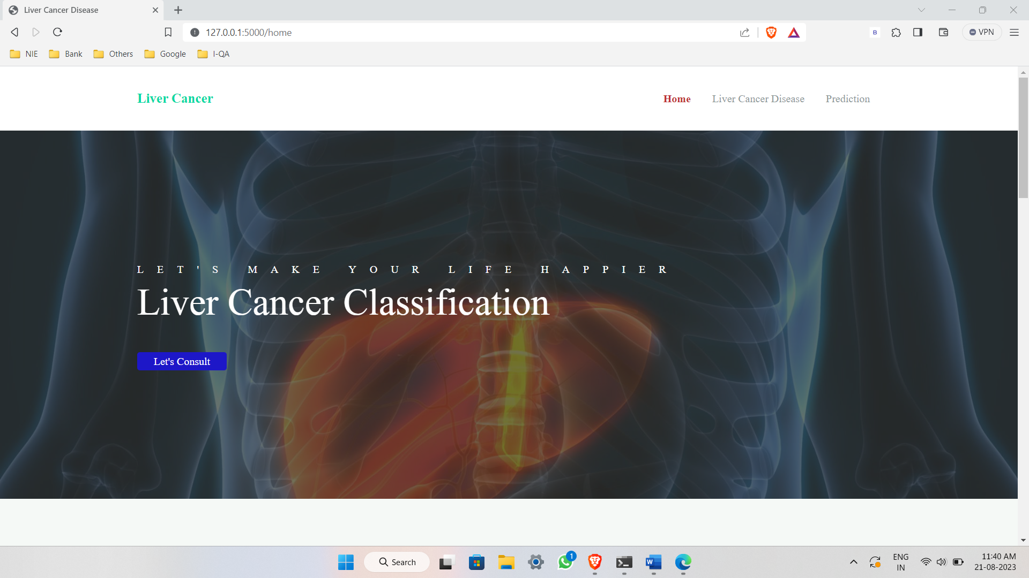
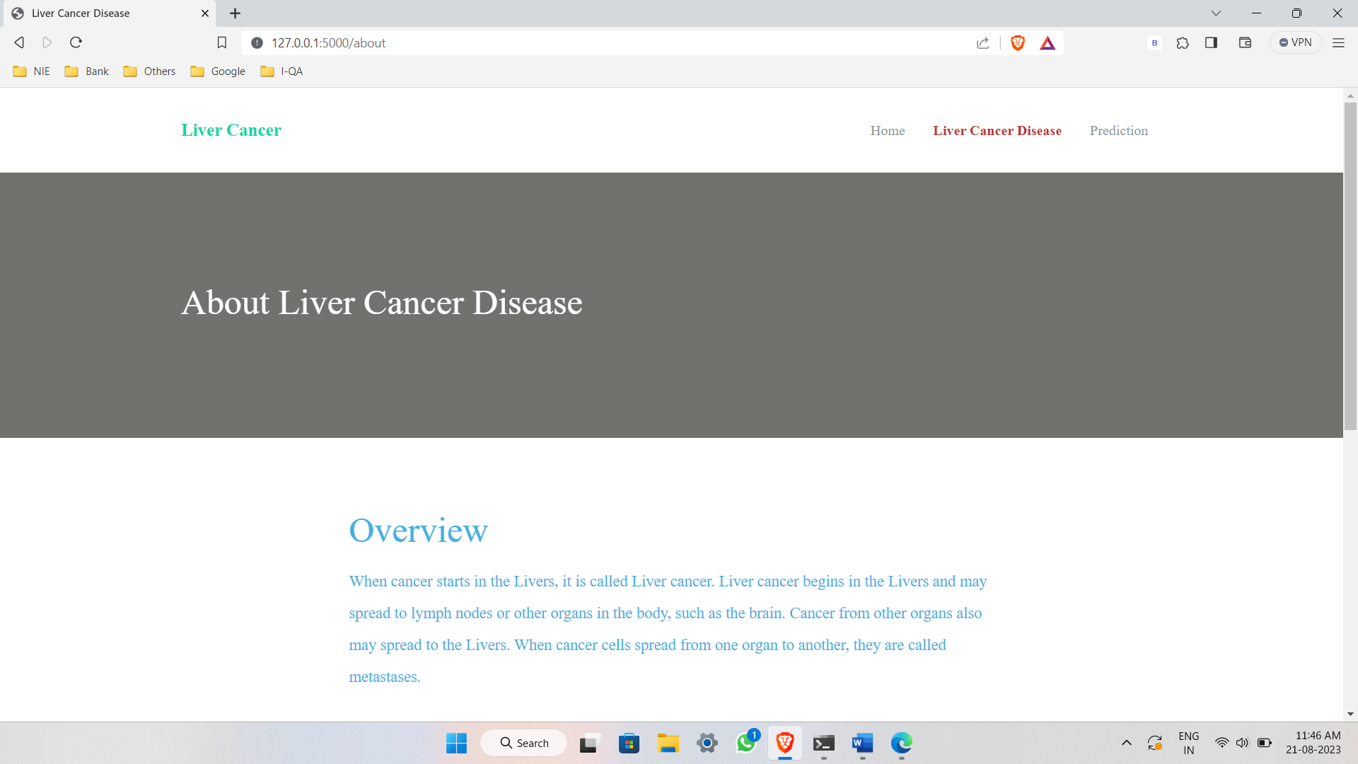
CONT…
Screenshot of Overview Page
Screenshot of Home page

Slide 21
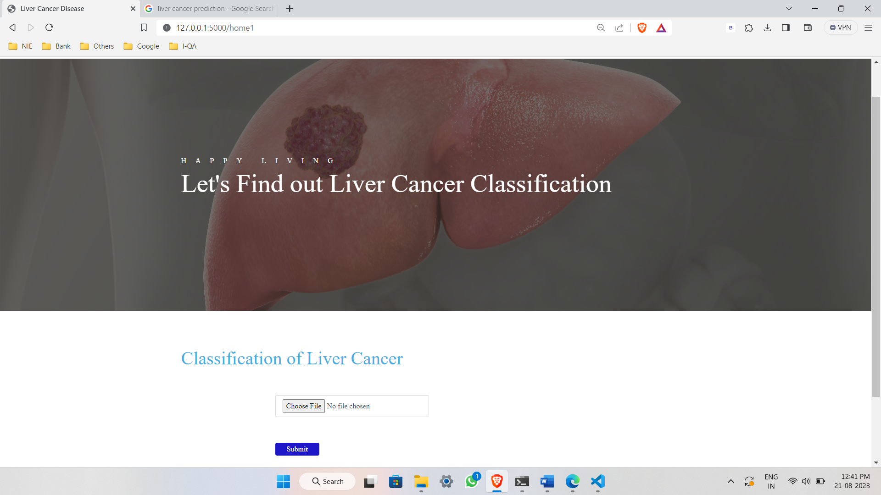
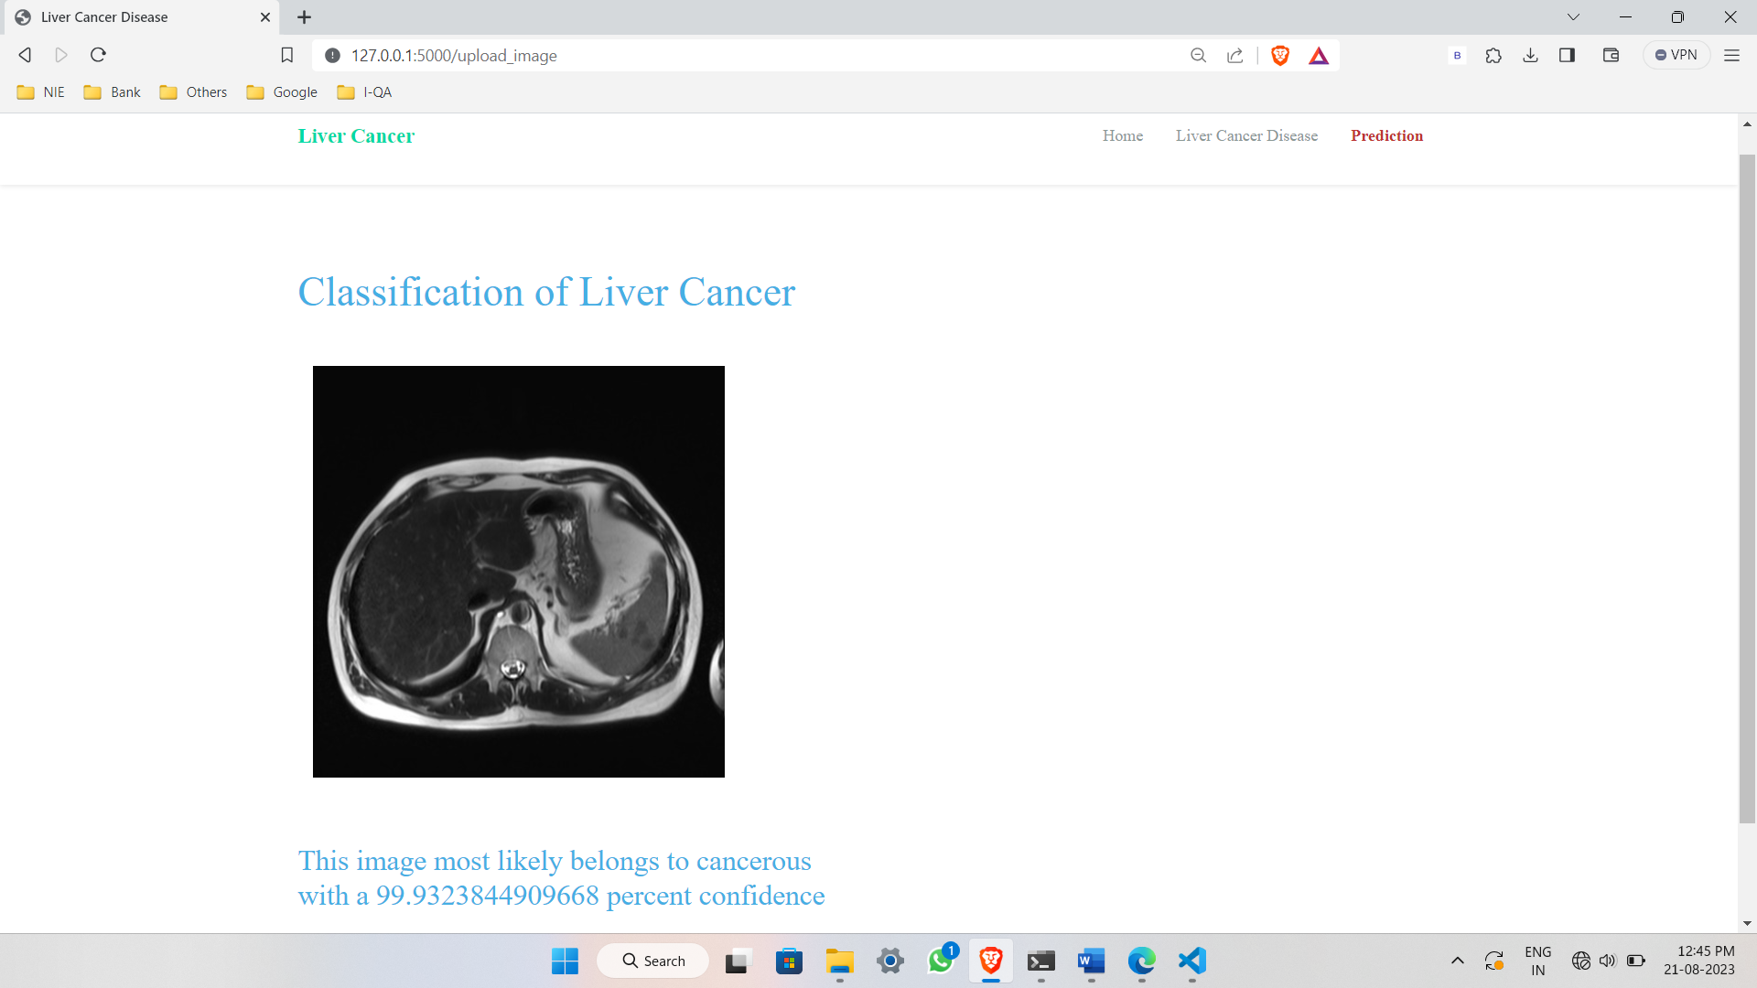
CONT…
Screenshot of Result
Screenshot of Prediction page

Slide 22
conclusion
The experiment successfully extracted features from liver and classified them using CNN a deep learning approach. The achievement of strong results was made possible by the use of CT scan image datasets for training and testing purposes. The effectiveness of the suggested technique is also examined through a thorough analysis of performance metrics. The combination of 2D feature maps and several slices revealed the potential for improving the precision of medical picture identification. This experiment demonstrates the promise of deep learning while also laying the groundwork for future initiatives to improve the detection of liver illness.

Slide 23
future enhancement
Exploring state-of-the-art deep learning techniques, such as Attention mechanisms, capsule networks, or Generative Adversarial Networks (GANs), to improve the effectiveness of the liver cancer classification model.
Integrating multiple imaging modalities, such as MRI, CT scans, or ultrasound, to leverage complementary information for more accurate liver cancer classification.

Slide 24


